Slide 1

Travel Data Analysis
Created By
Karishma Grover & Satyam Patel

Slide 2
Problem Statement
Since 2008, guests and hosts have used Airbnb to expand on traveling possibilities and present a more unique, personalized way of experiencing the world. This dataset describes the listing activity and metrics in Amsterdam in 2022-2023. The data file includes all the needed information to find out more about hosts, geographical availability, and necessary metrics to make predictions and draw conclusions.

Slide 3
Approach
Understanding Problem Statement
Collecting and understanding the data
Data Cleaning, Data Transformation, Data Modeling
Data Visualization using Power Bi

Slide 4
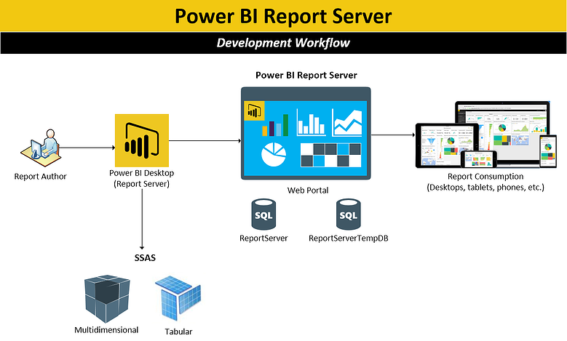

Slide 5
What is the benefit of AirBnB Data Analysis?
Airbnb Data Analysis is basically a data-driven strategy for managing the business. This will help to identify and address issues in your short-term rental plan. If you want to optimize your Airbnb listing to obtain more bookings, you’ll need comprehensive analytics for hosts—from real estate market data to Airbnb rental income. We were able to identify all challenges of the travel industry and how the booking system works. Airbnb analysis will also give insights on Earning, Hosting Progress, Occupancy and rates, Quality, and Conversions.

Slide 6
Which Data We Used It
For this project, we used data that give the listing summary from the city of Amsterdam for the years 2022-2023. Amsterdam is a city always buzzing with travelers. Good food, diverse crown, and vibrant culture make it a favorite travel destination for many. This dataset had a lot of important aspects.
List of items used:
Listing Id, Host Name, Host Id, Location/ Area name, Room Type, Latitude, Longitude, Count of amenities, Price, availability, Date, etc.
Using this information, we have figured most common Areas that were frequently booked or the Percentage of Client visits is higher.

Slide 7
Step Followed :
Collecting the data from the sources.
Performing the Data cleaning with the help of Excel, Python, and Power Query in which we removed irrelevant columns such as Neighborhood Group, name, sirvey_id, city, borough, mainstay, etc.
Splitting the route column by delimiter in Excel
Performing conditional replacement in currency sign in the price.
Converting Amenities names with the count of Amenities by using the Count function in Excel.
Converting the data type of price from string to float64 using .astype(float) command
Checking all duplicate values and replacing them with ‘0’
Finding Booked days by subtracting (365 – the availability of 365) at a particular neighborhood.

Slide 8
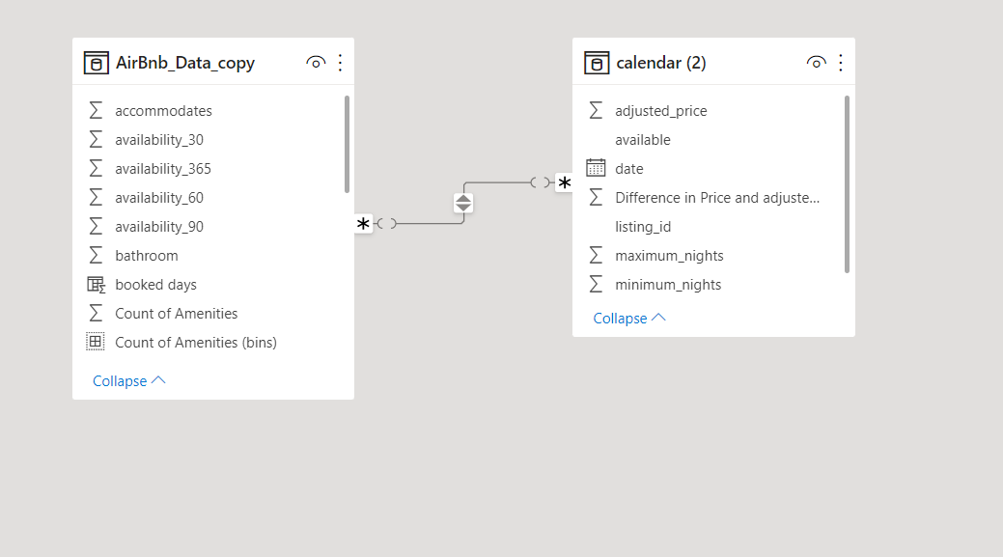
Continue…

Slide 9
Continue…
Created Calculated Bins for moving the by using group option in Power BI
Created Groups for the review score in order to measure them with reviews as Fine, Good, Average, Excellent.
Try to solve the problem statement by using different visuals in power bi.

Slide 10
Insights
﻿﻿1. At 349.58, 60 had the highest Average price and was 83.04% higher than 10, which had the lowest Average price at 190.98.
﻿﻿ ﻿﻿ Across all 7 Count of Amenities (bins), the Average price ranged from 190.98 to 349.58.﻿﻿ ﻿﻿ ﻿
2. The average price trended down, resulting in a 22.87% decrease between December 2022 and December 2023.﻿﻿ ﻿﻿ ﻿﻿The average price started trending down on December 2022, falling by 22.87% (59.77) in 12 months.﻿﻿ ﻿﻿ ﻿﻿The average price dropped from 261.39 to 201.62 during its steepest decline between December 2022 and December 2023.﻿﻿ ﻿﻿ ﻿
3. At 242.86, the Entire home/apt had the highest Average price and was 144.56% higher than the Shared room, which had the lowest Average price at 99.31.﻿﻿
4. ﻿﻿Entire home/apt had the highest Average price at 242.86, followed by Private room, Hotel room, and Shared room.﻿﻿

Slide 11
Continue…
5. Hotel rooms had 157.87 Average prices.﻿﻿ ﻿
6. ﻿﻿Across all 4 room types, the Average price ranged from 99.31 to 242.86.﻿﻿
7. At 306.89, De Baarsjes - Oud-West had the highest Average price and was 153.67% higher than Gaasperdam - Driemond, which had the lowest Average price 120.98.﻿﻿ ﻿﻿ ﻿
8. Across all 22 neighborhoods, the Average price ranged from 120.98 to 306.89.﻿﻿ ﻿﻿ ﻿
9. At 4.99, IJburg - Zeeburgereiland had the highest Average of longitude and was 4.04% higher than Osdorp, which had the lowest Average of longitude at 4.80.﻿﻿
10. Across all 22 neighborhoods, the Average longitude ranged from 4.80 to 4.99, the Average latitude ranged from 52.30 to 52.41, and the Average price ranged from 120.98 to 306.89.﻿﻿ ﻿﻿ ﻿

Slide 12
Thank you

